Slide 1
Vehicle Analysis Empowering consumers to make informed decisions when purchasing a car

Slide 2
Objectives
- Provide a comprehensive analysis of vehicle values for different car makes and models.
- Determine vehicle values of popular car brands over time.
- Identify key features that influence a car's value.
- Offer recommendations for consumers seeking high-value vehicles with better market value.

Slide 3

Overview of the Dataset Total Records: 1,874 Vehicle Makes: Audi, BMW, Honda, Hyundai, Land Rover, Mercedes-Benz, Toyota, and Volkswagen Price ranges: $7,794 – $152,925 Locations: Data pertains to vehicles primarily located in India. Years: Data covers vehicles manufactured between 2017 and 2021. Drivetrains: All Wheel Drive, Front Wheel Drive, Rear Wheel Drive Transmissions: Automatic vs. Manual Fuel Types: vehicles in the dataset are classified as either petrol or diesel.
7794
7794.315789473684

Slide 4








Distribution of car makes

Slide 5
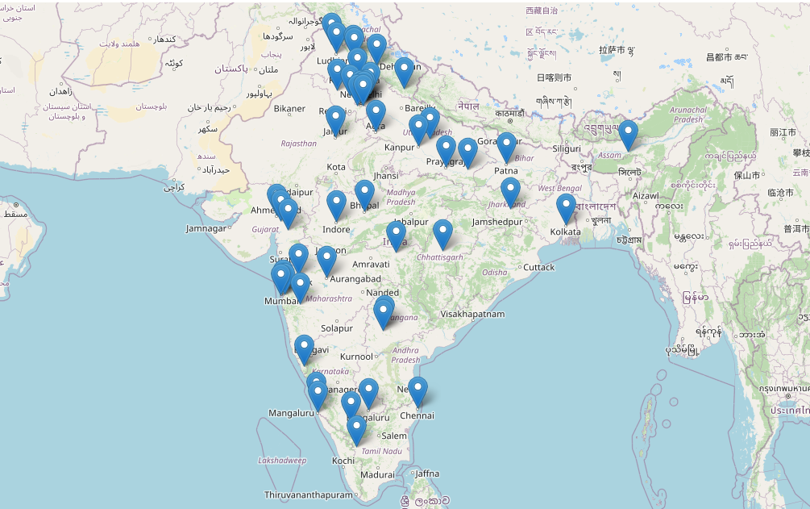
Geographic distribution (75 Countries)
Agra
Ahmedabad
Allahabad
Ambala Cantt
Amritsar
Aurangabad
Bangalore
Bhopal
Bhubaneswar
Bulandshahar
Chandigarh
Chennai
Coimbatore
Dak. Kannada
Dehradun
Delhi
Deoghar
Dharwad
Ernakulam
Faizabad
Faridabad
Ghaziabad
Goa
Gorakhpur
Gurgaon
Guwahati
Haldwani
Hyderabad
Indore
Jaipur
Jalandhar
Jamshedpur
Kanpur
Karnal
Kharar
Kheda
Kolkata
Kollam
Kota
Lucknow
Ludhiana
Mangalore
Meerut
Mirzapur
Mohali
Mumbai
Muzaffurpur
Mysore
Nagpur
Nashik
Navi Mumbai
Noida
Panchkula
Panvel
Patna
Pmpri-Chinchwad
Pune
Purnea
Raipur
Ranchi
Ranga Reddy
Rohtak
Roorkee
Rudrapur
Salem
Samastipur
Surat
Thane
Udupi
Vadodara
Valsad
Varanasi
Warangal
Yamunanagar
Zirakpur

Slide 6
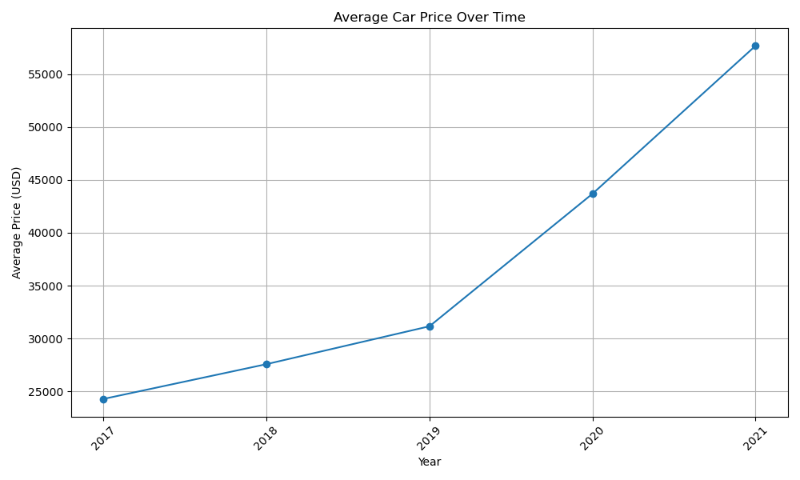
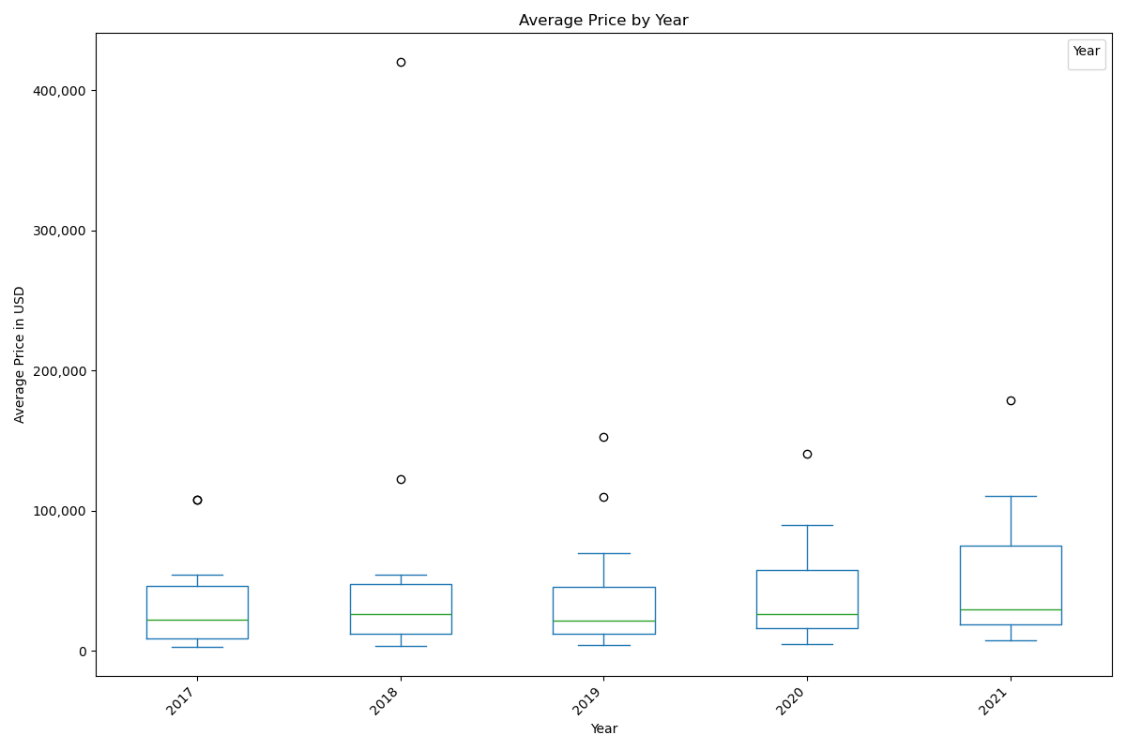
Car Price distribution over time
The largest increase occurs between 2018 and 2019, indicating a significant jump in car prices during that period.
The smallest increase is observed from 2020 to 2021, although prices still continue to rise.
The box plot analysis revealed significant variations in average car prices across different years.

Slide 7
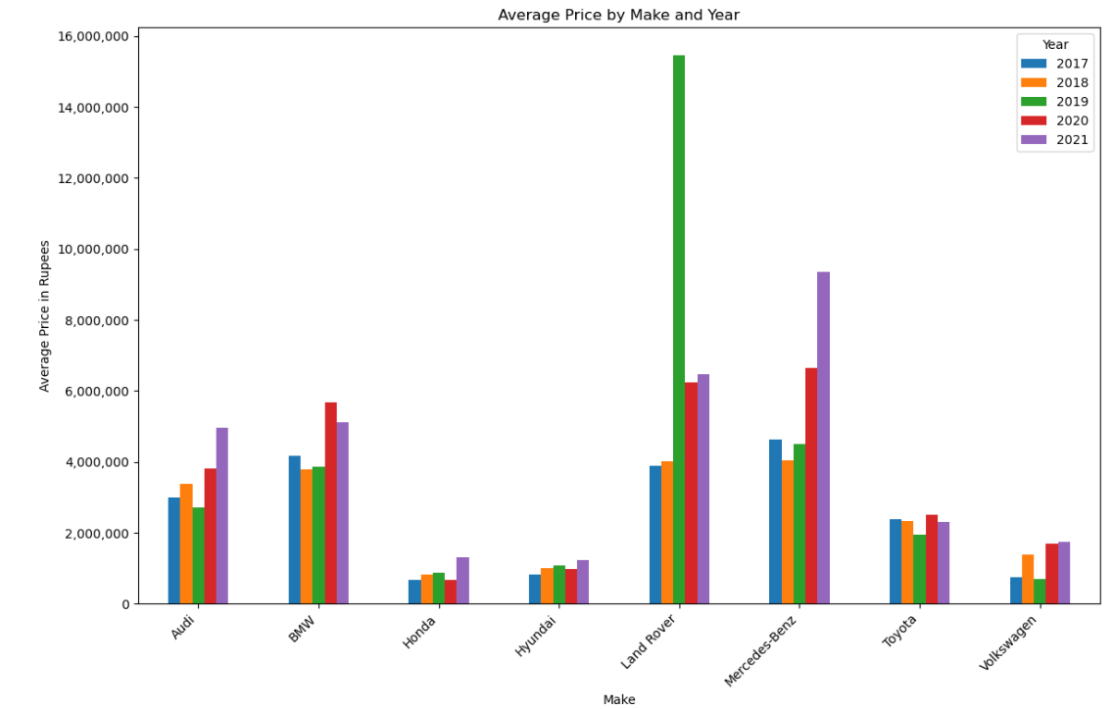
Average price by make and year
Honda and Hyundai show more stable pricing trends over the years, while Land Rover, Volkswagen exhibit more significant fluctuations.
Luxury brands like Audi, BMW, Mercedes-Benz, and Land Rover tend to have higher average prices

Slide 8
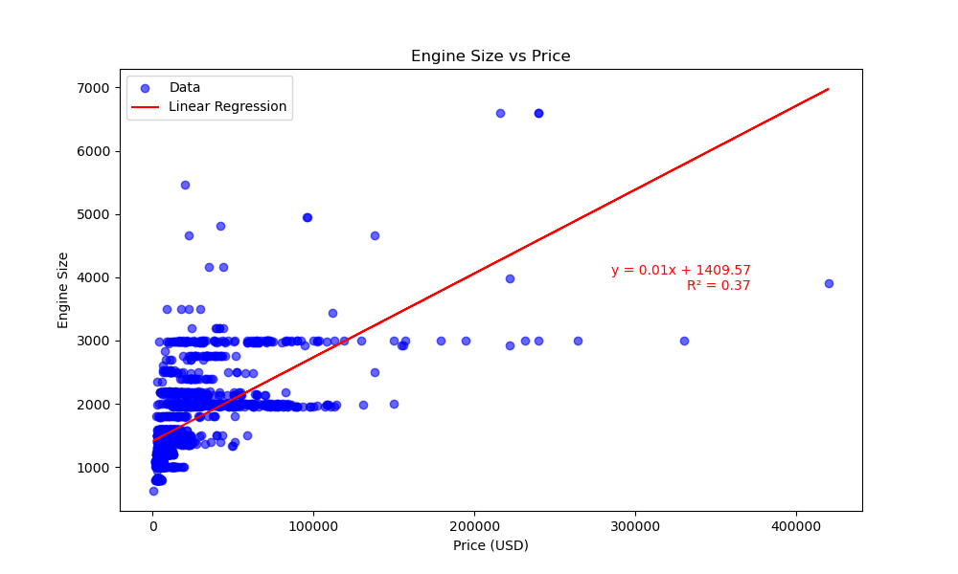
Engine size vs. price
The linear regression map indicates a positive relationship between engine size and price. As engine size increases, there's a tendency for the price of cars to also increase.
This suggests that larger engine sizes are often associated with higher-priced vehicles.
The coefficient of determination (R²) associated with the regression model quantifies the proportion of variance in price that can be explained by changes in engine size.
A higher R² value indicates a stronger relationship between the variables.

Slide 9
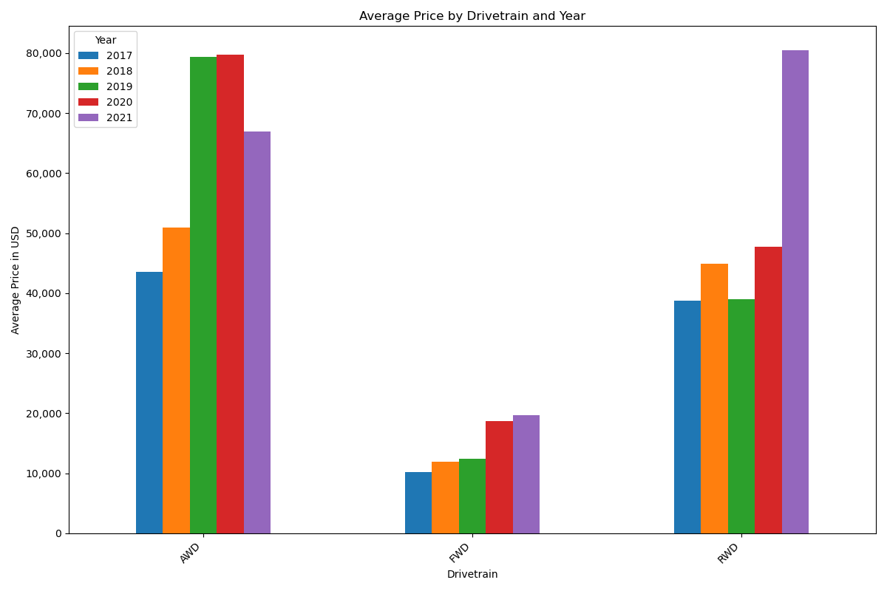
Price by Drivetrain and Year
AWD vehicles consistently commanded higher prices compared to FWD and RWD vehicles, indicating perceived value and market demand for all-wheel-drive systems.
Prices of AWD and RWD vehicles generally increased over the years, possibly due to technological advancements or changes in consumer preferences.

Slide 10
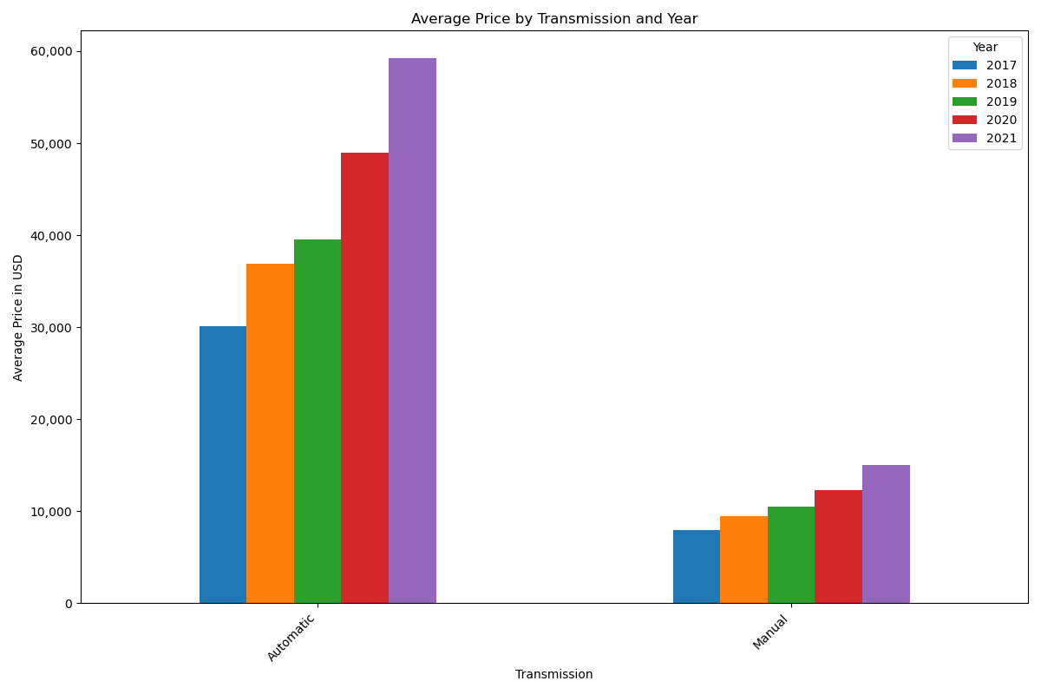
Transmission vs. price
Automatic transmission vehicles generally commanded higher prices than manual transmission vehicles, reflecting market preferences and convenience factors.
Prices of both automatic and manual transmission vehicles showed increasing trends over the years, potentially influenced by inflation and market dynamics.

Slide 11
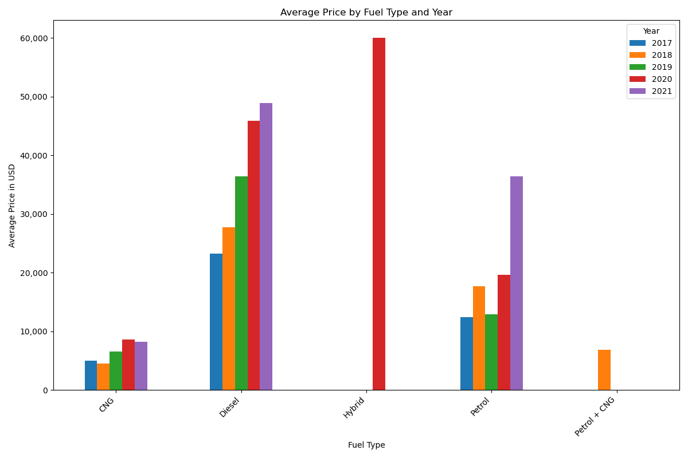
Fuel type vs. price
Diesel vehicles exhibited higher average prices compared to petrol and alternative fuel vehicles, likely due to factors such as fuel efficiency and market demand.
Prices of hybrid vehicles showed notable fluctuations, possibly influenced by technological advancements and government incentives.

Slide 12
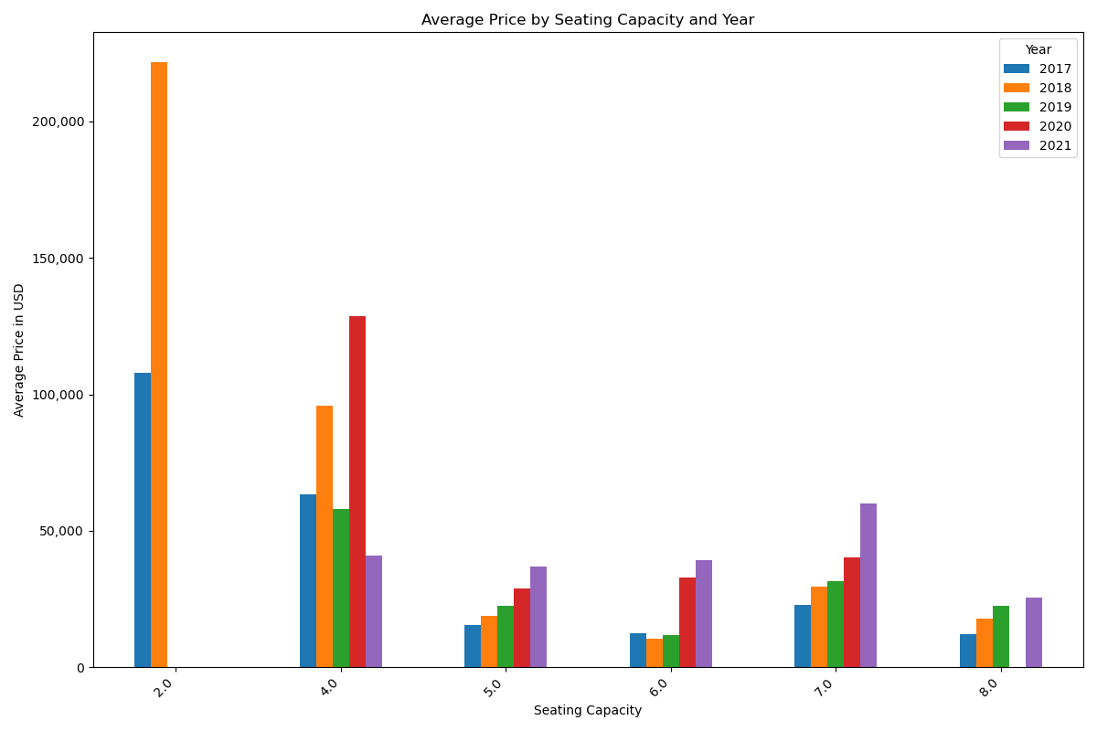
Seating capacity vs. price
Vehicles with higher seating capacities, such as 7-seaters and 8-seaters, generally commanded higher average prices, reflecting the perceived value of larger vehicles.
Prices of 7-seater vehicles showed a significant increase over the years, possibly driven by market demand for SUVs and family-oriented vehicles.

Slide 13

Conclusion and key insights
Price Variation: Significant price variations exist between makes, with premium brands commanding higher prices.
Drivetrain Impact: All-wheel-drive vehicles consistently fetch higher prices, reflecting market demand.
Engine Size vs. Price: A positive relationship exists between engine size and price, indicating a preference for larger engines.
Transmission Trends: Automatic transmissions correlate with higher prices, with an overall increasing price trend.
Fuel Type Dynamics: Diesel vehicles generally have higher prices, while hybrid prices fluctuate.
Seating Capacity Influence: Larger seating capacities correlate with higher prices, especially for 7- and 8-seater vehicles.
In conclusion, the analysis underscores the diverse factors influencing car prices, from brand prestige to drivetrain preferences and seating capacity demands. This comprehensive understanding empowers consumers to navigate market complexities, adapt strategies, and capitalize on emerging trends, ensuring sustained success in the ever-evolving automotive landscape.

Slide 14
THANK YOU
Anna Ramer
annaramer@yahoo.com
Ben Fish
Benjamin.Fish426@gmail.com

